Slide 1

Vel Tech Rangarajan Dr. Sagunthala R&D Institute of Science and Technology
School of Computing
Department of Computer Science and Engineering
10211CS224 / FULL STACK APPLICATION DEVELOPMENT (JAVA)
END SEMESTER PROJECT REVIEW
Date: 06-05-2026
DESIGN AND DEVELOP A REACT JS BASED WEB APPLICATION FOR TICKET BOOKING OF AN INTERNAL DEPARTMENT EVENT
SDG: SDG 9 – Industry, Innovation and Infrastructure
Presented By:
Muthyala Muni Sai Teja – VTU24670 – 23UECS0816
Courses Handling Faculty:
Dr. S. Hemamalini/Associate Professor
(Senior Grade)

Slide 2
INTRODUCTION
Traditional manual event handling in departments leads to inefficient tracking, overbooking, and a lack of real-time visibility.
This project centralizes event management into a secure, automated platform, ensuring transparent ticket distribution and data accuracy.
In professional and academic settings, such systems are vital for coordinating seminars and workshops with high reliability.
The solution is a full-stack application leveraging a robust Spring Boot REST API and a modern React-based frontend.
It features role-based access secured via JWT authentication, protecting sensitive user data and administrative booking flows.
Admins benefit from a dedicated analytics dashboard with live-refreshing charts to monitor attendance and event capacity.
Users enjoy a seamless, mobile-responsive interface designed with a bold Neo-Brutalist aesthetic for enhanced engagement.
This system provides a scalable, digital-first model for managing internal logistics and improving organizational productivity.
1
2
3
4
5
6
7
8
9

Slide 3
PROBLEM STATEMENT
Current departmental event management often relies on fragmented manual processes, leading to data inconsistencies and frequent overbooking.
There is a critical lack of real-time visibility for students trying to browse events and administrators tracking attendance.
Existing methods are prone to human error, making it difficult to manage ticket capacity or verify registrations securely.
The absence of a centralized, role-based system often results in unauthorized access and inefficient logistical planning.
Inaccurate data reporting prevents administrators from making informed decisions regarding event scaling and resource allocation.
This project addresses these challenges by replacing manual workflows with a fully automated, JWT-secured full-stack application.
It ensures absolute data integrity through a synchronized Spring Boot backend and provides immediate insight via live analytics.
The system offers a reliable, digital solution to eliminate paperwork and improve the overall efficiency of internal event coordination.
1
2
3
4
5
6
7
8
9

Slide 4
OBJECTIVE(S)
To design and develop a full-stack automated booking platform using React and Spring Boot to streamline event registration and eliminate manual paperwork.
To implement JWT-secured role-based access control and a real-time analytics dashboard to monitor ticket distribution and prevent event over-capacity.
To improve departmental efficiency by providing users with instant booking confirmations and a centralized digital history of all reserved event tickets.
To evaluate the performance of real-time data synchronization through live-refreshing analytics that monitor ticket availability across concurrent user sessions.
1
2
3
4
5
6
7
8
9

Slide 5
PROPOSED SYSTEM
The proposed system is a full-stack web application featuring a modern React frontend and a robust Spring Boot REST API for automated event logistics.
It implements a secure role-based access control system using JWT authentication, ensuring that administrative and user functions are strictly isolated.
By centralizing event listings, the platform eliminates the need for manual inquiries and provides users with a comprehensive digital catalog of all upcoming activities.
The system solves the primary issue of overbooking by utilizing a synchronized backend database that enforces strict ticket capacity limits in real-time.
It replaces paper-based registries with a digital booking flow, significantly reducing human error and the time required for data entry and verification.
A dedicated administrator dashboard provides live-refreshing visual analytics, offering immediate insight into event popularity and resource allocation.
Compared to traditional methods, the platform offers 24/7 accessibility, allowing students to browse and book tickets from any device at their convenience.
The modular architecture ensures high scalability, enabling the department to manage an unlimited number of concurrent events and high-volume traffic efficiently.
1
2
3
4
5
6
7
8
9

Slide 6
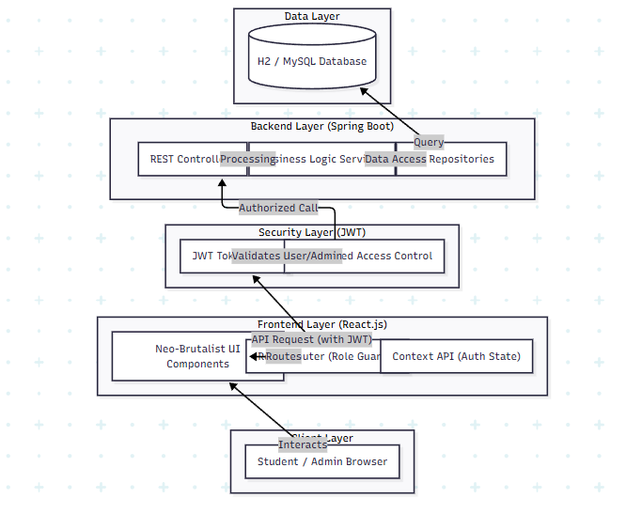
PROPOSED SYSTEM ARCHITECTURE
1
2
3
4
5a
6
7
8
9

Slide 7
PROPOSED SYSTEM ARCHITECTURE
1. Input
User/Admin Credentials: Secure login and registration data (Email, Password, Role).
Event Details: Admin inputs for event titles, descriptions, dates, and total ticket capacity.
2. Processing
Authentication & Authorization: Validating JWT tokens and enforcing role-based access (Admin vs. User permissions).
Capacity Logic: Back-end validation to ensure ticket bookings do not exceed the set event capacity.
3. Database (MySQL)
User Profiles: Persistent storage of hashed credentials, user roles, and account metadata.
Centralized Event Store: A structured table for maintaining all event information and inventory levels.
4. Output
Dynamic UI Components: Responsive React pages displaying filtered event lists and booking details.
Visual Analytics: Interactive charts (Bar/Pie/Line) showcasing real-time booking stats for administrators.
1
2
3
4
5b
6
7
8
9

Slide 8
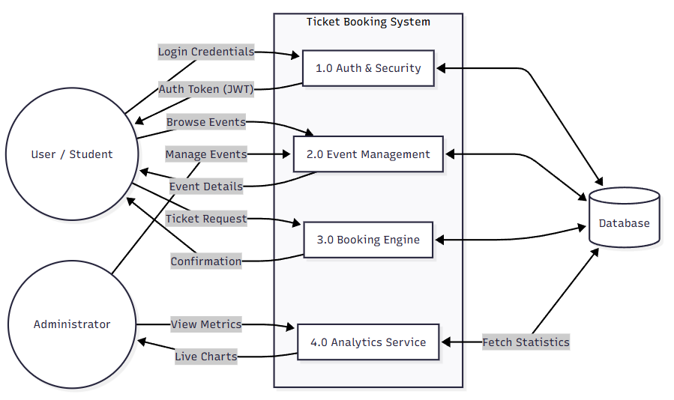
WORKFLOW
1
2
3
4
5
6
7
8
9

Slide 9
TECHNOLOGIES USED
Frontend: React.js, Vite, Axios, Recharts (for analytics), Neo-Brutalist CSS.
Backend: Spring Boot, Java 17, Spring Security (JWT), Maven.
Database: MySQL.
Tools: VS Code, Postman, Git, Chrome DevTools.
Hardware/Software Requirements: 8GB RAM, i3+ CPU, Node.js v18+, JDK 17, Modern Web Browser.
1
2
3
4
5
6
7
8
9

Slide 10
MODULE DESCRIPTION
Internal Department Event Ticket Booking System:
Module 1: Authentication & Access Control Handles secure user registration, JWT-based login, and role-based access for ADMIN and USER accounts.
Module 2: Event Lifecycle Management Enables administrators to create, update, and manage departmental events, including setting descriptions and ticket capacities.
Module 3: Booking & Reservation System Manages the core ticket discovery and booking process for students, featuring real-time availability checks to prevent overbooking
.
Module 4: Real-Time Analytics Dashboard Generates visual insights through interactive charts, allowing administrators to monitor booking trends and ticket distribution efficiently.
1
2
3
4
5
6
7
8
9

Slide 11
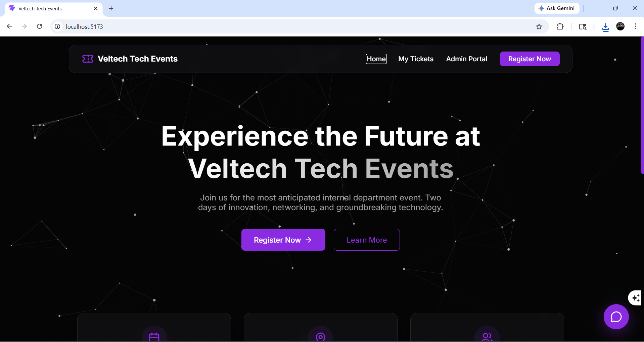
IMPLEMENTATION SCREENSHOTS
Home Page (Event List):
The primary discovery module for students, providing a centralized, high-contrast interface to browse upcoming departmental events and real-time ticket availability.
1
2
3
4
5
6
7
8(a)
9

Slide 12
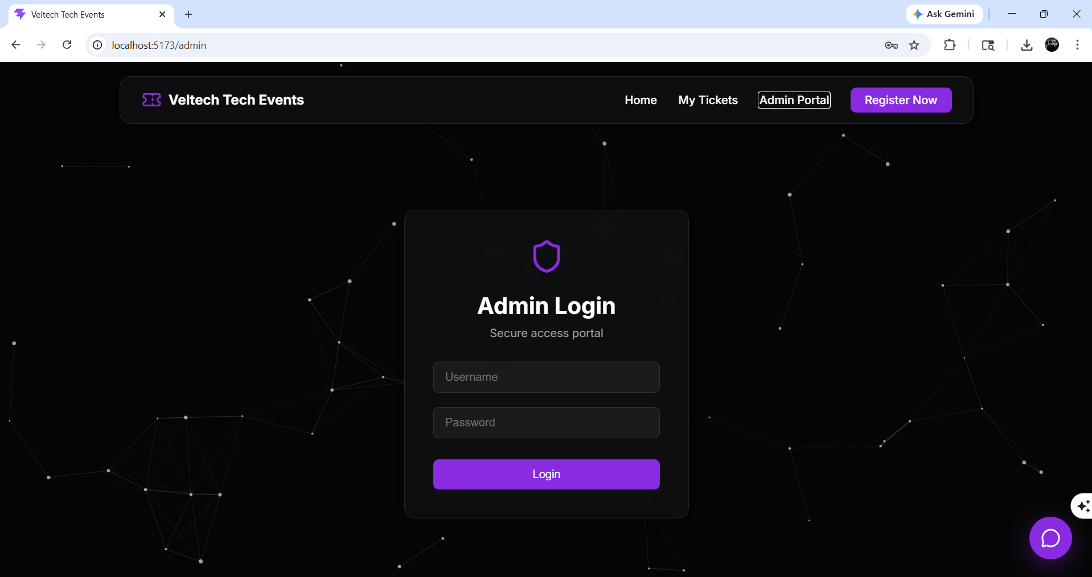
IMPLEMENTATION SCREENSHOTS
Login Page:
The secure entry gate of the system where users and admins authenticate via JWT to access their respective role-based dashboards.
1
2
3
4
5
6
7
8(b)
9

Slide 13
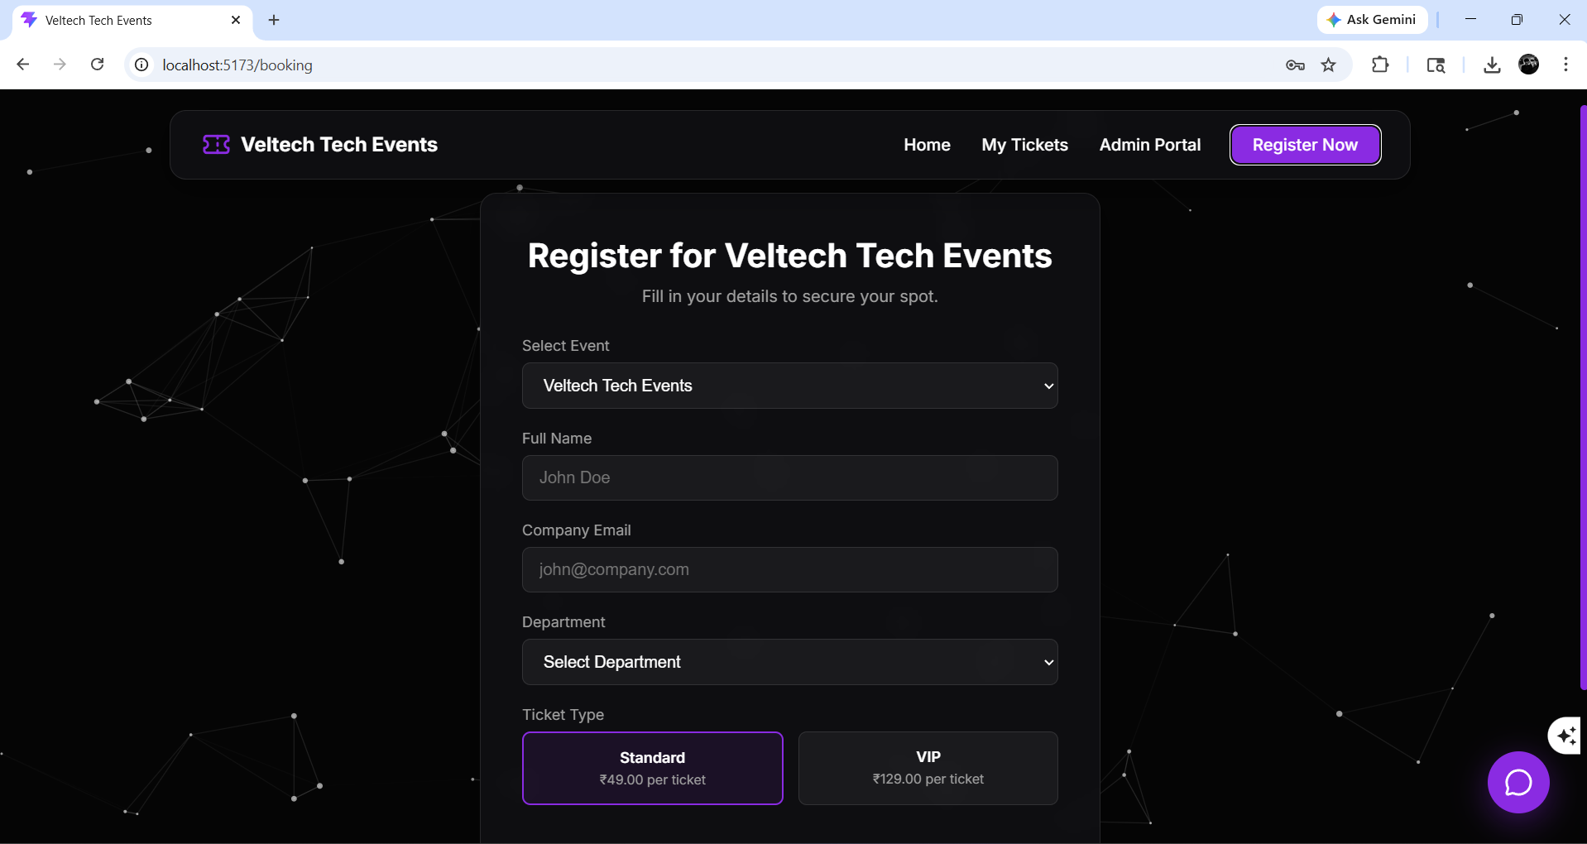
IMPLEMENTATION SCREENSHOTS
Main Module (Admin Dashboard):
The central control hub for administrators, displaying critical KPIs such as total events, active bookings, and total registered users at a glance.
1
2
3
4
5
6
7
8(c)
9

Slide 14
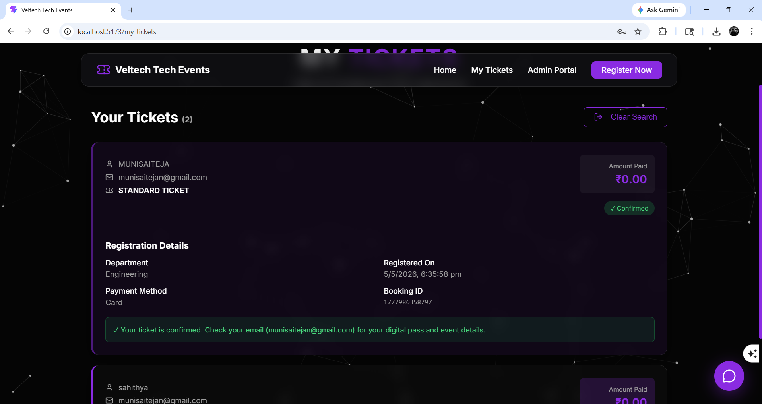
IMPLEMENTATION SCREENSHOTS
Output Page (Analytics/History):
This module features real-time visual analytics and personalized booking history, transforming raw data into actionable insights and convenient user records.
1
2
3
4
5
6
7
8(d)
9

Slide 15
ADVANTAGES & LIMITATIONS
Advantages
Automated Efficiency: Replaces slow manual registration with an instant digital booking flow, eliminating paperwork and human error.
Real-Time Tracking: Provides both students and admins with up-to-the-second visibility into ticket availability and event status.
Role-Based Security: Uses JWT authentication to ensure that sensitive admin features and booking APIs are strictly protected from unauthorized access.
Actionable Analytics: The dedicated dashboard simplifies complex data into visual charts, helping admins optimize event planning and resource allocation.
Limitations
Network Dependence: As a web-based platform, the system requires a stable internet or local intranet connection to process bookings.
Volatile Data (Dev Mode): In its default development configuration (MySQL Database), all transactional data is cleared whenever the server is restarted.
Digital Access Required: The system relies on users having access to a computer or mobile device, which may be a barrier for offline registration.
Scoped for Internal Use: The current architecture is optimized for a single department and would require significant scaling for university-wide or public events.
1
2
3
4
5
6
7
8
9

Slide 16
Thank you

